Slide 1
MN: Environmental and health conditions compared to poverty
Group 1
November 20, 2023
Eric Johnson, Paul Moses, Waynei Mebrahtu, Mitchell Lor, Lucinda Hodgson

Slide 2
Disclosures
None
Notes:
We have no disclosures

Slide 3
General hypothesis
There will be higher levels of pollutants, and higher incidence of certain health issues in MN counties where there are more households living under the poverty line.
Decided to focus on the ones with the most complete data for the largest time span: arsenic, heart attack and cancer
Notes:
We wanted to look at the relationship between pollution, health issues and poverty in MN
Our thought was that we might find evidence that higher levels of poverty would be correlated with higher incidence of disease as well as environmental pollution. This has been shown in other research

Slide 4
Design
Look at 10 years of public data from MN
Census Bureau, MN Department of Health, Center for Disease Control
Sort by county and poverty rate
Test the data for a correlation between poverty and chosen variable
Consider looking at counties, rural/urban and state level
Merged our chosen metrics with census data by county
Analyzed each set
Notes:
We looked at 10 years of data in MN that we gathered from census bureau and mn dept of health
We sorted by county and poverty to understand what poverty looks like in MN(more on that in a bit)
We tested Heart attack, cancer and arsenic level against poverty
We looked at Lead levels, asthma and air particulates but each had their own data issues

Slide 5

Data sources
MN department of health: https://www.health.state.mn.us/data/index.html
US Census: https://www.census.gov/data/developers/data-sets.html
CDC: https://data.cdc.gov/
Notes:
Also used other sources for background data, listed in our final resources/reference slide

Slide 6
Terms/definitions
Arsenic:
Tasteless, colorless, odorless
U.S. Environmental Protection Agency has set the maximum contaminant level (MCL) of arsenic in public drinking water at 10 parts per billion (ppb), and the FDA adopted this level for bottled water
Levels are higher in rural communities in the Midwest and water from private wells
Sources of arsenic: mining and fracking, coal-fired power plants, arsenic-treated lumber, and arsenic-containing pesticides, food and as a naturally occurring element

Slide 7
Terms: cont
Heart attack: A heart attack (myocardial infarction), happens when the flow of blood that brings oxygen to a part of your heart muscle suddenly becomes blocked. The heart can't get enough oxygen. If blood flow is not restored quickly, the heart muscle will begin to die.
Cancer: Cancer is a disease in which some of the body’s cells grow uncontrollably and spread to other parts of the body.
Poverty Level: Poverty is measured in the United States by comparing a person's or family's income to a set poverty threshold or minimum amount of income needed to cover basic needs. The U.S. Census Bureau is the government agency in charge of measuring poverty. The official poverty definition uses money income before taxes and does not include capital gains or noncash benefits (such as public housing, Medicaid, and food stamps).
Poverty Threshold: $ amount used to determine poverty status

Slide 8
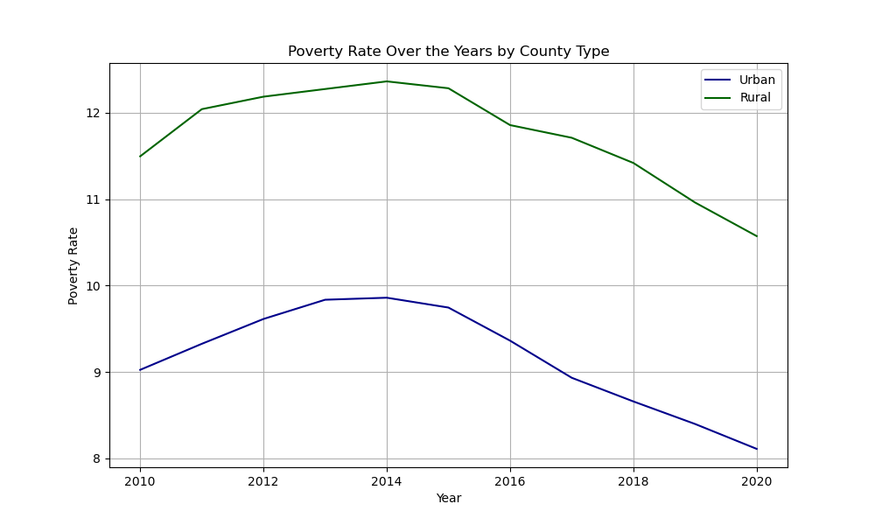
Poverty in MN
The poverty rate= ratio of the number of people (in a given age group) whose income falls below the poverty line
2022 8.6% MN
Better that national rate (11.5%)
disparities
13.7 % northwest region
3.8% Washington County
10.2% MN over age 65
Chart, poverty/time
Notes:
To understand the data we will be presenting, we want to start by talking about poverty in MN specifically. The poverty rate= ratio of the number of people (in a given age group) whose income falls below the poverty line. In 2022 the poverty rate in MN was 8.6%, which is much better that the national poverty rate of 11.5%. However, there are disparities within MN, the northwest region has poverty rate of 14% while Washington county is at 4%. And as you can see from the line graph, poverty rates historically are higher in rural areas as compared to urban.

Slide 9
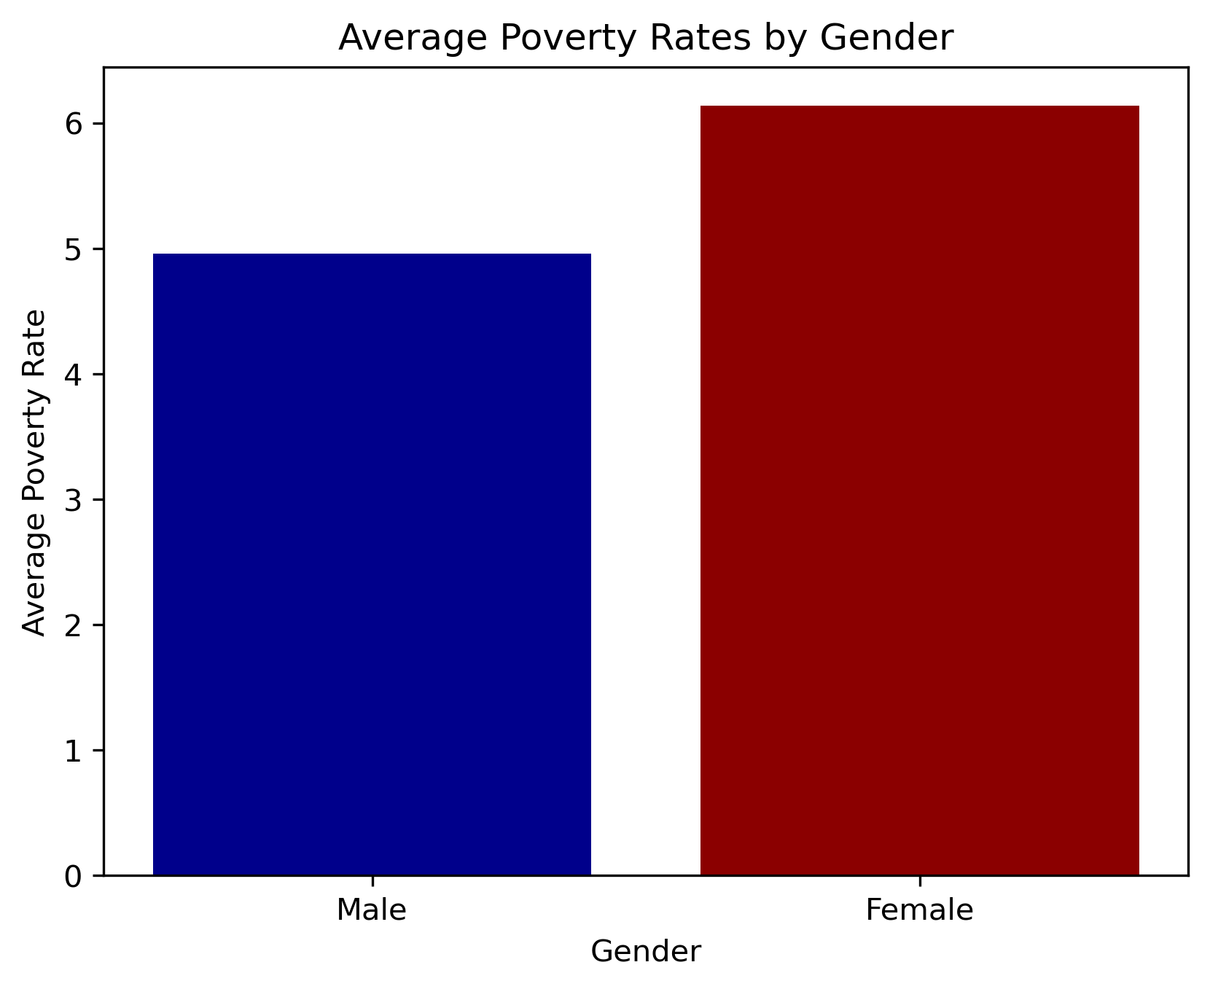
Average Poverty Rates by Gender, MN, all years

Slide 10
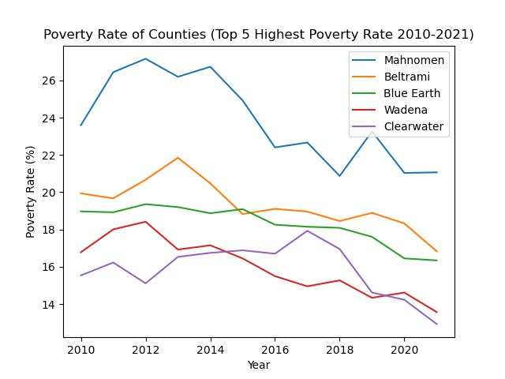
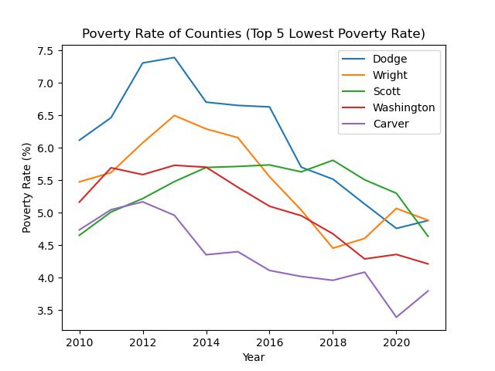
Lowest and highest counties by year
Notes:
These line graphs from our census data show that in the top 5 and bottom 5 counties, the poverty rate is declining.

Slide 11
Arsenic and poverty:
Specific hypothesis:
Arsenic levels will be higher in counties with higher poverty rates, as measured by groundwater levels over 10 years.
Notes:
Mitchell: Initial thought was that areas with industrial or farm pollution would be less affluent and more rural. Reminder anything over 10 ppb (ug/L) considered too high

Slide 12
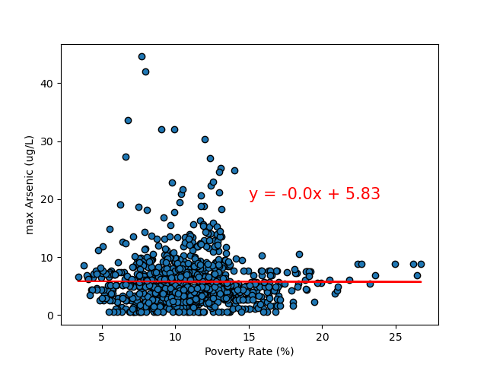
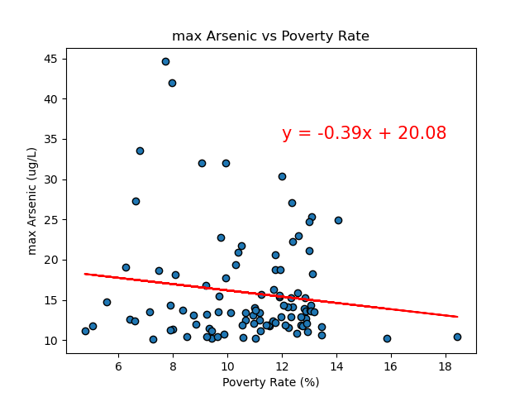
Max Arsenic level(ug/L) v Poverty Rate(%)
All counties (all years)
Top 5 highest poverty rate counties (all years)
All counties: max Arsenic vs Poverty Rate
Notes:
This is all counties compared to poverty level, and again,
Our thought that since this is an environmental pollutant that is generally higher in MN than elsewhere, and we are only looking at counties, it is reasonable that no signal would show up in this data overall
There are certain counties where it is much higher, but it is likely from historic pollution.
Every county with elevated arsenic rates is rural

Slide 13
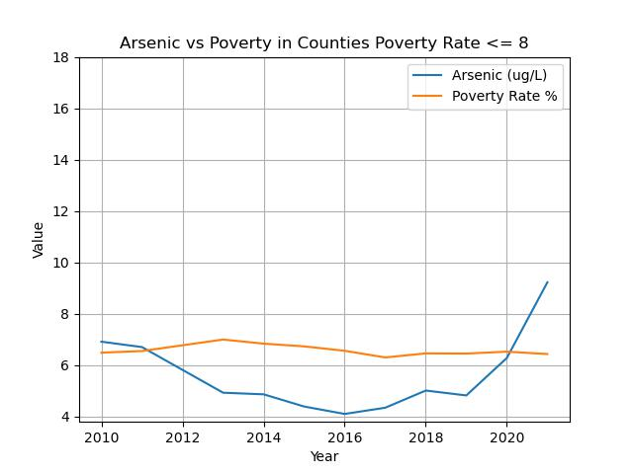
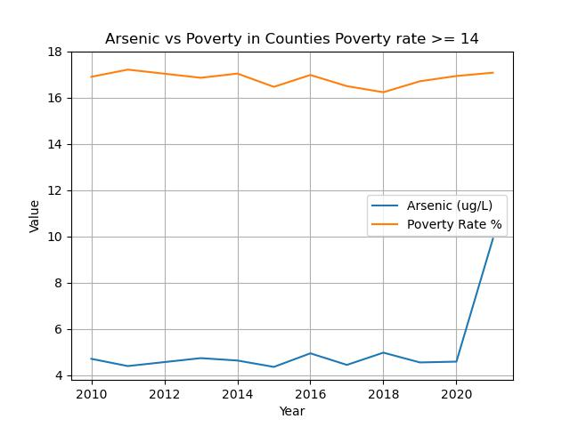
Arsenic v poverty rate (<=8% or >=14%)
Notes:
Counties with equal to or greater than 14% poverty rate
Counties with equal to or less than 8%
Would want to look at the counties that spiked in 2020 in the future

Slide 14
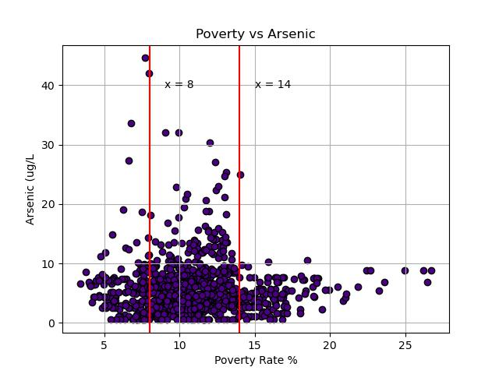
Max Arsenic Vs Poverty Rate
Notes:
When we slice up the data based off low/high poverty, it seems like there could be some correlation in each of the categories.

Slide 15
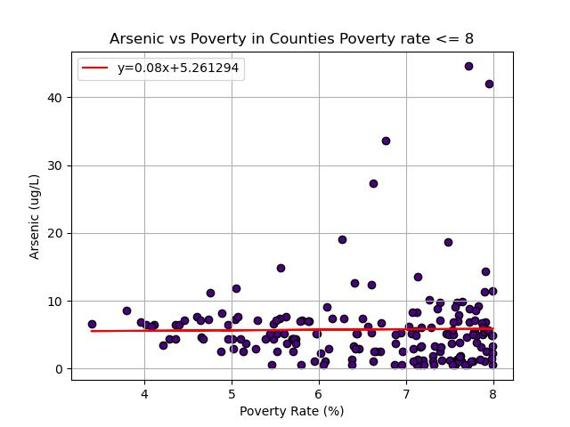
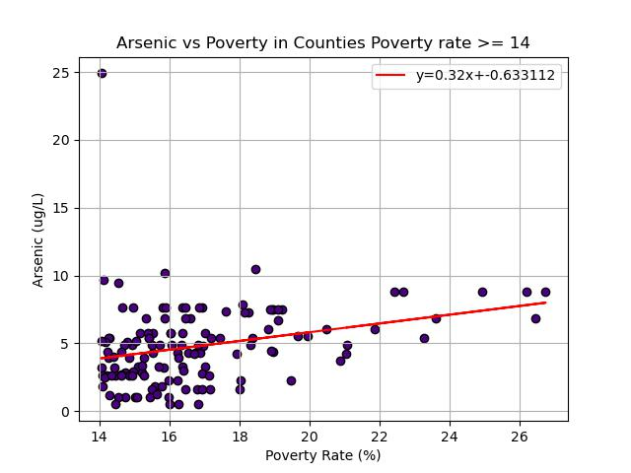
Low Poverty Vs High Poverty
Notes:
Poverty/Arsenic has no correlation in Low Poverty Counties
Poverty/Arsenic has a weak positive correlation in High Poverty Counties
However this does not prove our Hypothesis since it does not take into account ALL counties.

Slide 16
Heart Attack
Specific hypothesis
Heart attack rates will be higher with elevated poverty rates.
Notes:
Eric: {Hypothesis}
Poverty Data was obtained from the Census API
Heart attack data was obtained from the MN Public Health Data Access Page with CSV data
Heart attack death data was pulled from the CDC

Slide 17
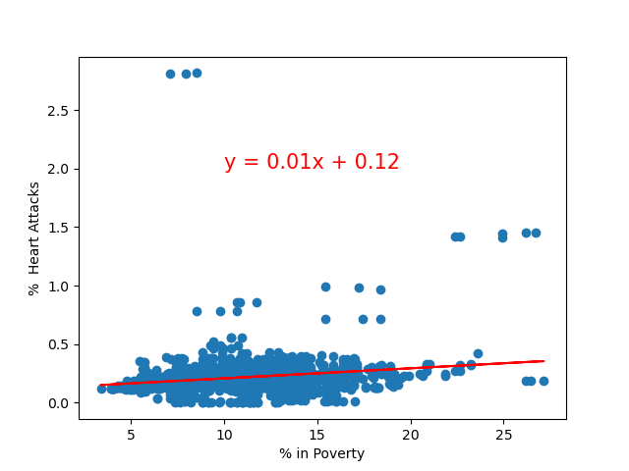
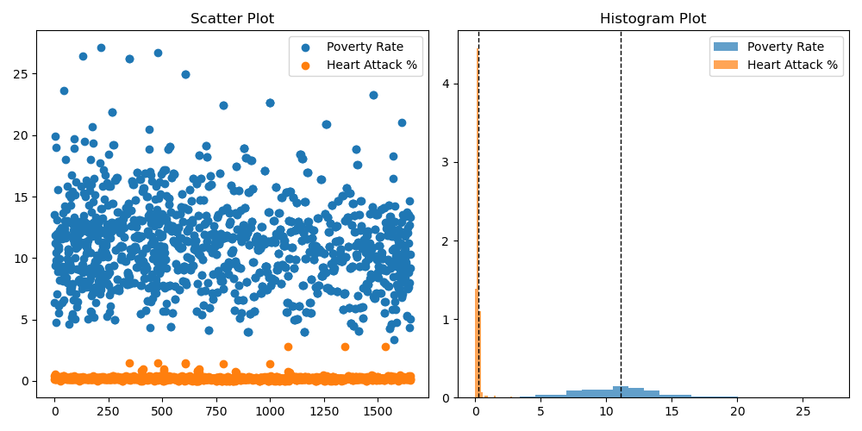
Linear Regression and T-tests
Linear Regression, Poverty v Heart attack
Notes:
When running a linear regression, the R-squared was close to 0 and we were unable to determine a linear relationship between poverty and heart attacks.
When running a t-test, the p-value was 0, but we questioned these results based on the r-squared and also looking at which counties had the highest levels of poverty, and which had the highest levels of heart attacks.
There wasn’t much overlap between the two.
The results were inconclusive though the way the data was collected and aggregated may have been skewing the results.

Slide 18
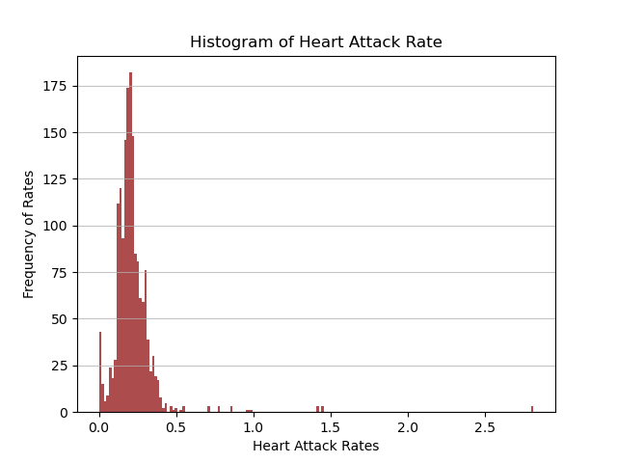
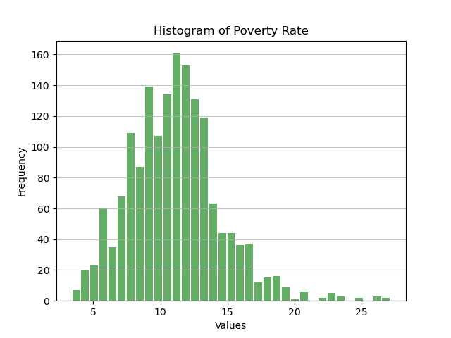
Histograms: Heart Attack and Poverty Rate
Notes:
For instance, the distribution of the data was somewhat different, showing different p-values when tested and shown in these histograms.
We did look at deaths related to heart related issues as well but found similar results.

Slide 19
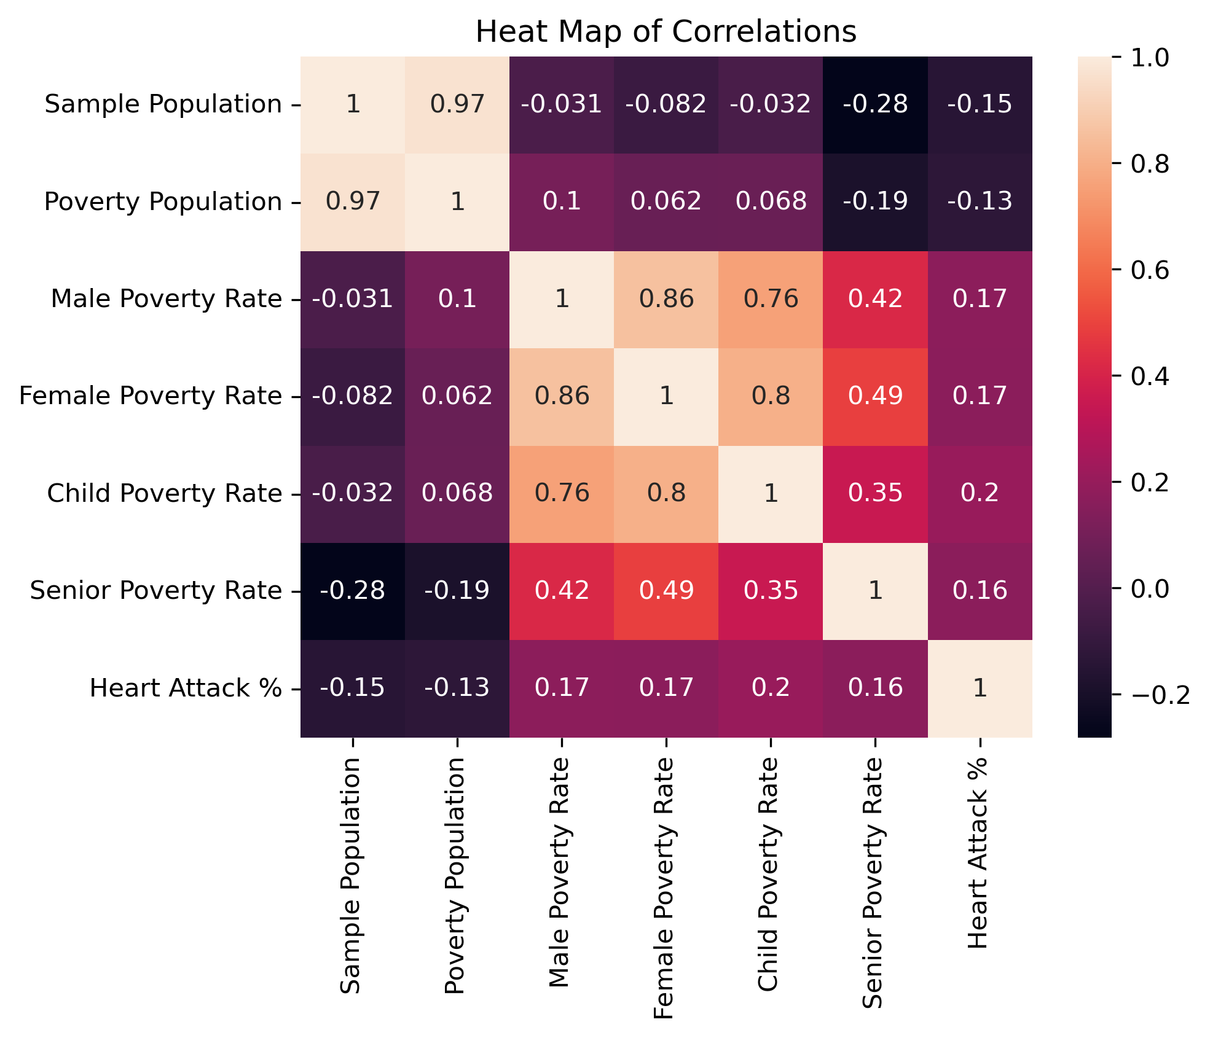
Heart Conclusion
Notes:
Eric:
Well documented research has shown that work stress and financial stress are associated with a higher risk of heart attack.
https://www.ncbi.nlm.nih.gov/pmc/articles/PMC4541436/
https://www.nih.gov/news-events/nih-research-matters/stress-links-poverty-inflammation-heart-disease
https://hms.harvard.edu/news/low-income-people-have-heightened-heart-attack-death-risk-6-world-health-systems
While we could not find support that heart attack rates are correlated with poverty rates (see heat map), that doesn’t mean there is no correlation.
Further analysis would be needed such as pulling more nuanced definitions of poverty, getting heart attack data for specific populations, looking at larger data sets, etc.

Slide 20
Cancer and poverty
Specific hypothesis
Cancer levels will be higher in counties with higher poverty rates.

Slide 21
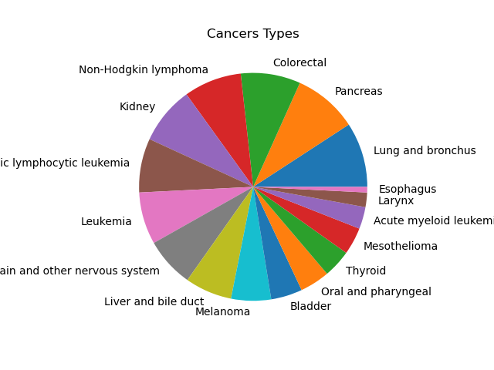
Cancer Types
Notes:
We know that death from cancer is directly affected by poverty, but not incidence and that was clear in our data. If we were looking at death rates from cancer we may have seen a correclation.

Slide 22
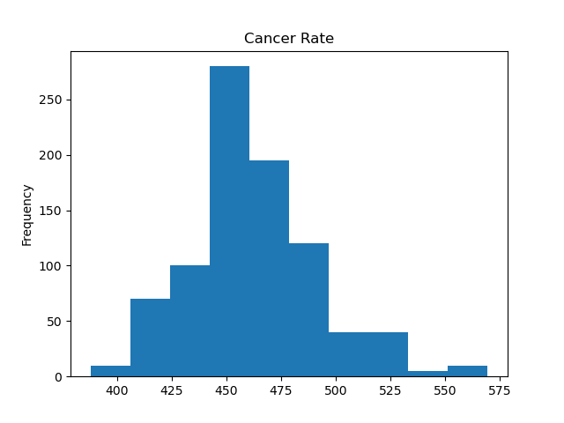
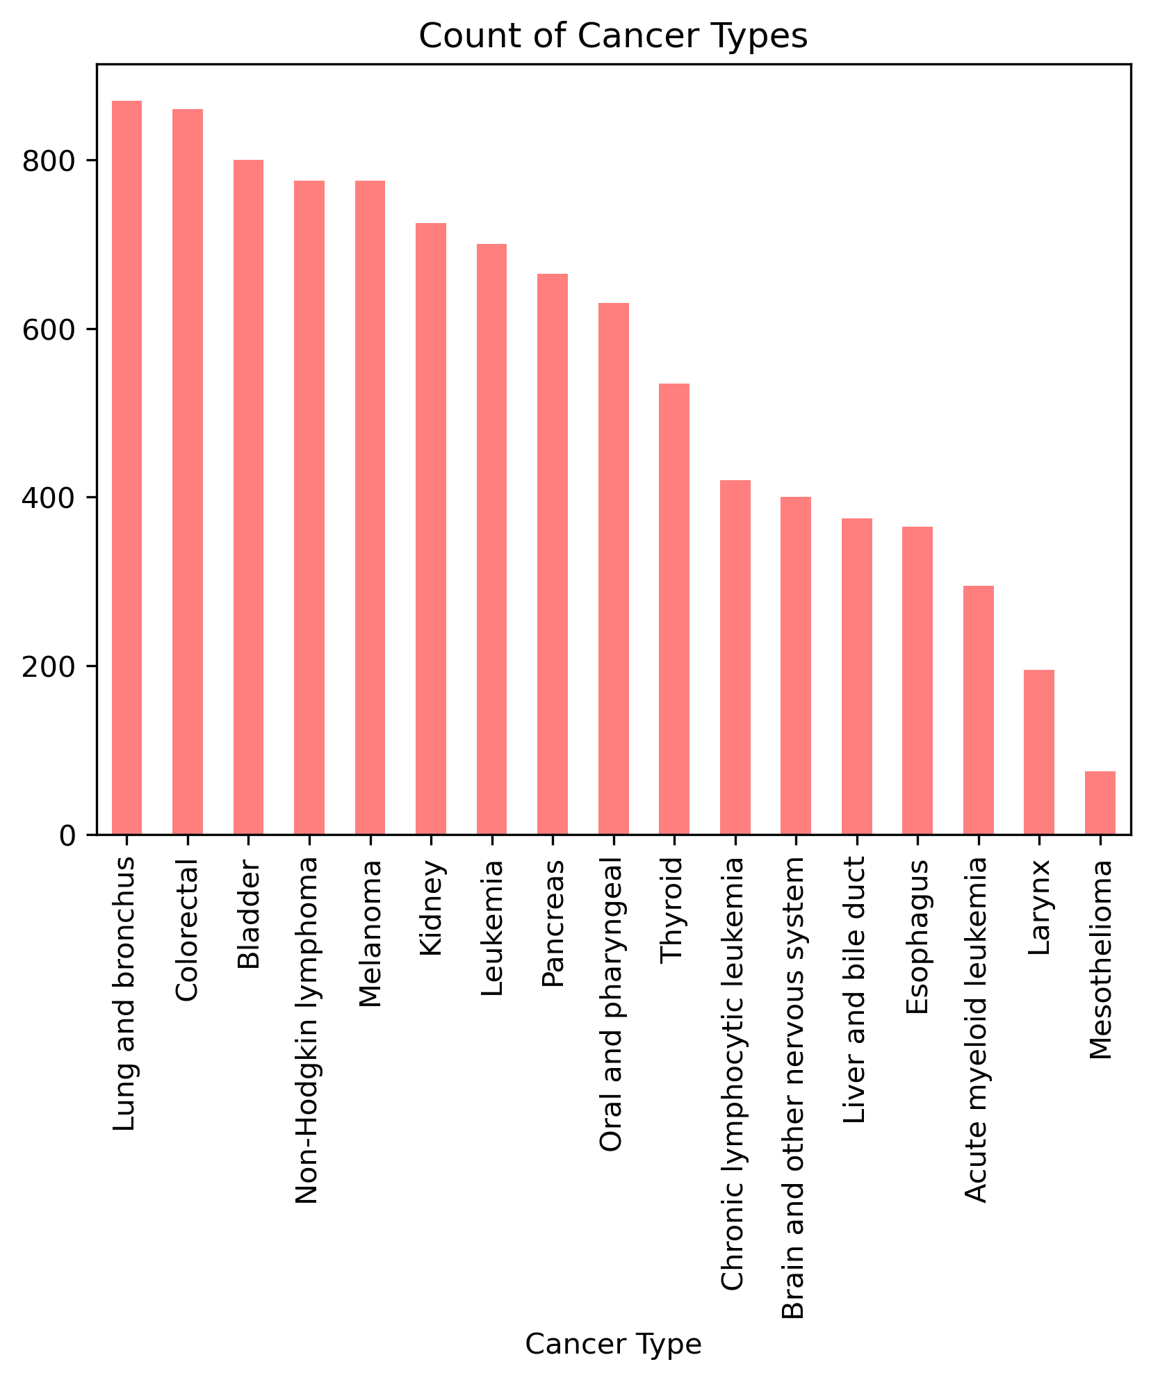
Cancer
Notes:
We know that death from cancer is directly affected by poverty, but not incidence and that was clear in our data. If we were looking at death rates from cancer we may have seen a correclation.

Slide 23
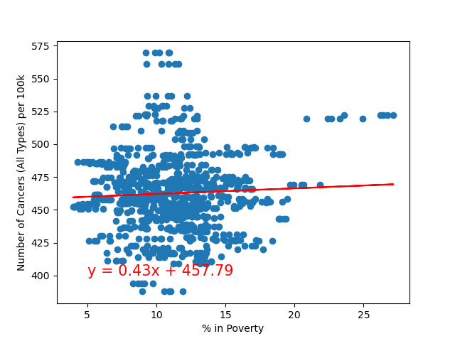
cancer
cancer rate v poverty rate

Slide 24
Conclusion /
limitations
Our data showed no obvious correlation between poverty and the variables we chose
Our results suggest further study or more granular data is needed as we know in at least one category there is a known correlation
County data likely too broad for looking at poverty
Census tract data might be a better source
End point revision (cancer deaths as opposed to incidence)

Slide 25
Resources
Arsenic:
https://www.fda.gov/food/environmental-contaminants-food/arsenic-food-and-dietary-supplements#:~:text=To%20reduce%20health%20risks%20associated,for%20bottled%20water%20as%20well.
https://www.ncbi.nlm.nih.gov/pmc/articles/PMC4186553/
https://www.niehs.nih.gov/health/topics/agents/arsenic/index.cfm#:~:text=Arsenic%20levels%20tend%20to%20be,of%20arsenic%20in%20certain%20locations.
Poverty Level:
https://www.irp.wisc.edu/resources/how-is-poverty-measured/#:~:text=Poverty%20is%20measured%20in%20the,in%20charge%20of%20measuring%20poverty.
https://www.census.gov/topics/income-poverty/poverty/guidance/poverty-measures.html
https://www.hhh.umn.edu/news/minnesota-poverty-report-finds-income-disparities-persist-minnesota
https://www.census.gov/topics/income-poverty/poverty/guidance/poverty-measures.html
Heart Attack:
https://www.fda.gov/food/environmental-contaminants-food/arsenic-food-and-dietary- supplements#:~:text=To%20reduce%20health%20risks%20associated,for%20bottled%20water%20as%20well.
Cancer:
https://www.cancer.gov/about-cancer/understanding/what-is-cancer#:~:text=Cancer%20is%20a%20disease%20caused,are%20also%20called%20genetic%20changes.
https://www.ncbi.nlm.nih.gov/pmc/articles/PMC6291807/#:~:text=Both%20work%20stress%20and%20financial,with%20minimal%20or%20no%20stress.

